Slide 1

Postal MAIL Tracking & Delivery System
INFO 5707 – Data Modeling for Information Professionals
Project Group 13
Rohith Singh Thakur, Varshith Bala, Vamshi Kodali
Rohith Singh Thakur • Built SQL tables and implemented database structure • Created detailed data dictionary • Validated data accuracy and logic
Varshith Bala • Built SQL tables, insertions, and queries • Ensured database met user requirements • Prepared final report and presentation
Vamshi Kodali • Designed ERD using Draw.io • Organized system specs and presentation content • Ensured entity alignment with user needs

Slide 2
Objective & Scope
Objective: To develop a organized and efficient postal delivery system that allows shipment tracking, accounts for delivery attempts, and stores customer input. The system's focus is to increase delivery transparency, notification management, and proof of delivery to enhance customer satisfaction.
Scope:
Tracks package delivery status including pending, in transit, failed, and delivered.
Records all delivery attempts with date, time, and reason for success or failure.
Documents secured proof of delivery using signatures or images. Gathers customer ratings and commentary for service measurement.
Determines chargeable shipping cost from varied costs including base cost, weight, and distance.

Slide 3
User Requirements
The system will record and display delivery status updates such as “Out for Delivery,” “Delivered,” or “Delayed” based on entries in the database.
Shipment statuses and their last updated times can be retrieved through SQL queries by system administrators
The system must securely store proof of delivery (with a digital signatory or a photo of the delivery along with a timestamp).
The customer should be able to leave feedback regarding the entire delivery experience (e.g., a rating & optional comments).
The system must calculate and display the total shipping fee for each delivery, adding together the different cost factors involved.

Slide 4
Business Rules & System Functionality
A package must be assigned to a driver and a delivery route before it is shipped.
If a delivery does not get completed, the attempt should be documented with a timestamp and a reason why the delivery was unsuccessful.
If there is no legitimate proof of delivery for a package, it cannot be considered delivered.
Only registered customers can provide feedback about their deliveries.
Each shipment payment must be related to a particular delivery and all the cost details must be present to complete the billing procedures.

Slide 5
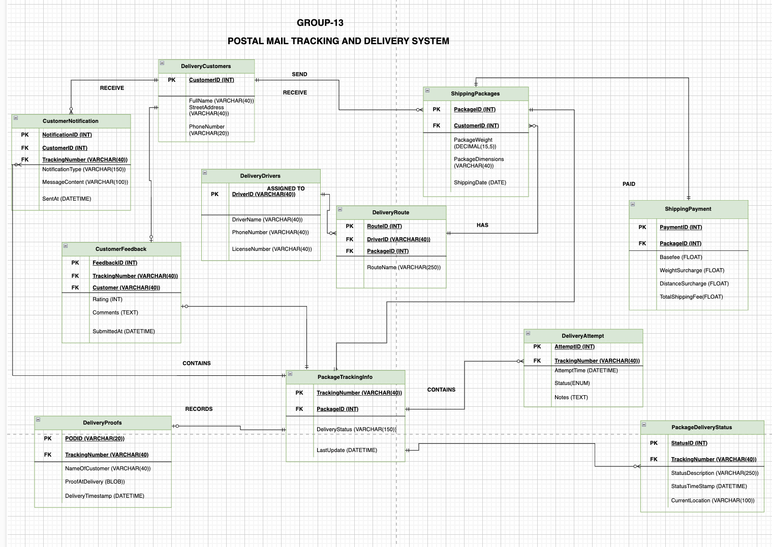
Entity Relationship Design (ERD)
ERD shows relationships between key entities: DeliveryCustomers, ShippingPackage, DeliveryDriver, DeliveryRoute, PackageTrackingInfo, DeliveryAttempt, DeliveryProof, ShippingPayment, CustomerNotifications, CustomerFeedback, and PackageDeliveryStatus.

Slide 6
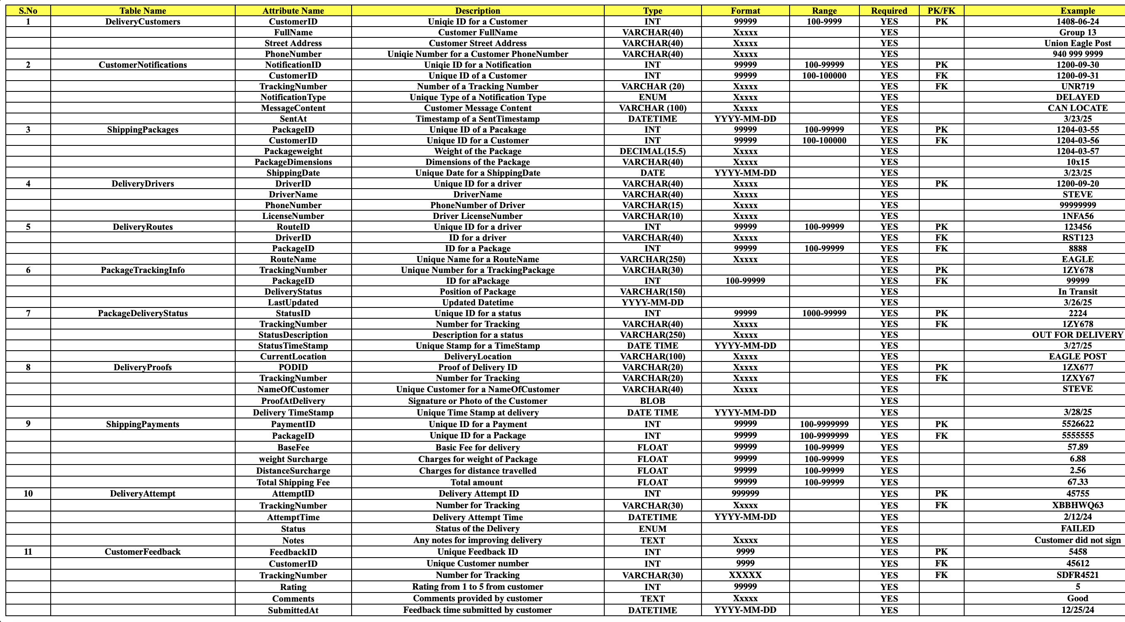
Data Dictionary

Slide 7
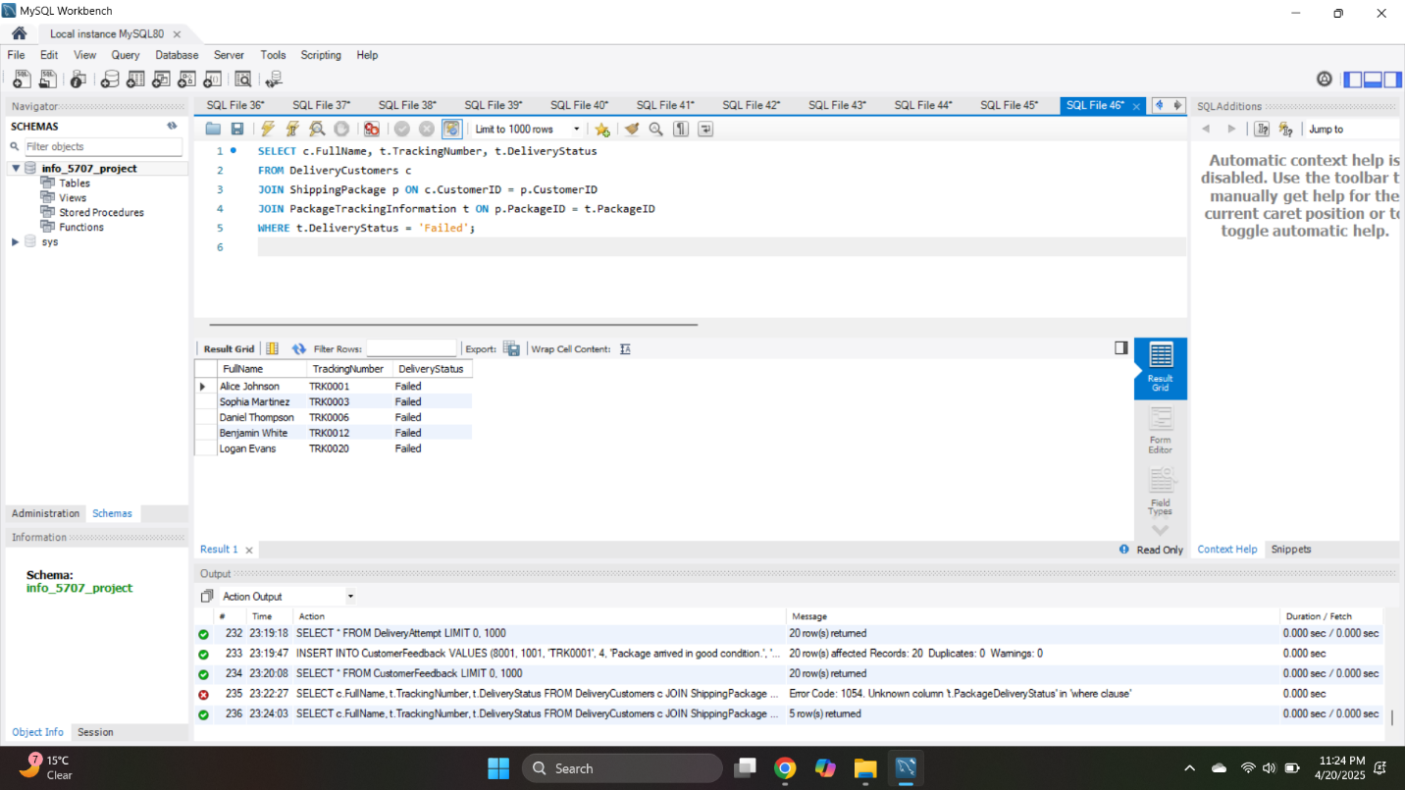
Query Insights: Failed Deliveries
Query 1 - Failed Deliveries
This query returns customer names and tracking numbers for all packages that were marked as “Failed”.
It is useful to an administrator for identifying and following up on packages that were not successfully delivered to customers.

Slide 8
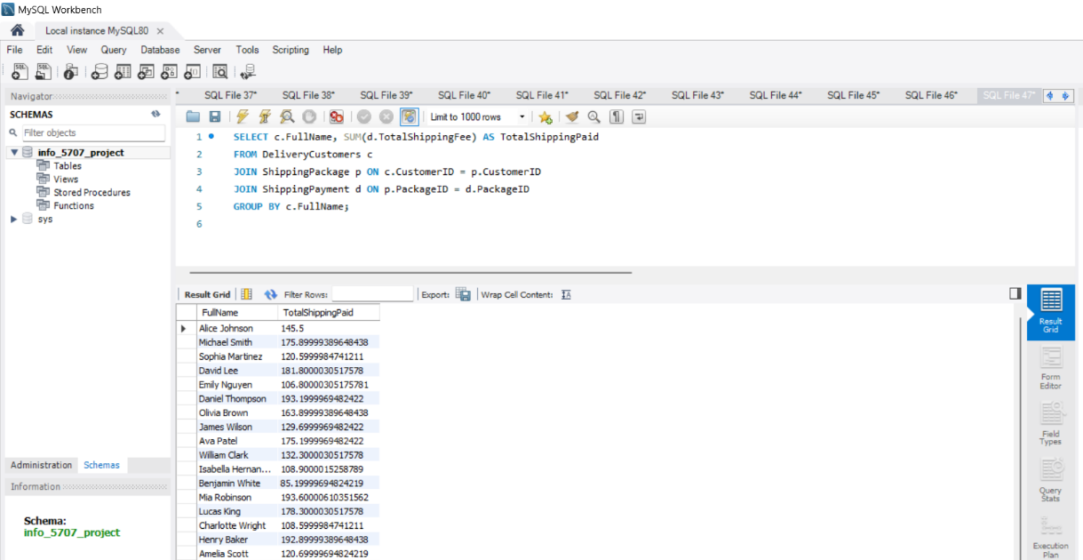
Query Insights: Total Shipping Cost
Query 2 - Total Shipping Fees by Customer
This query returns a sum of total shipping fees paid by customer using a SUM() grouping the results by customer name.
It supports accounting and financial reporting measures as well as understanding customer billing patterns.

Slide 9
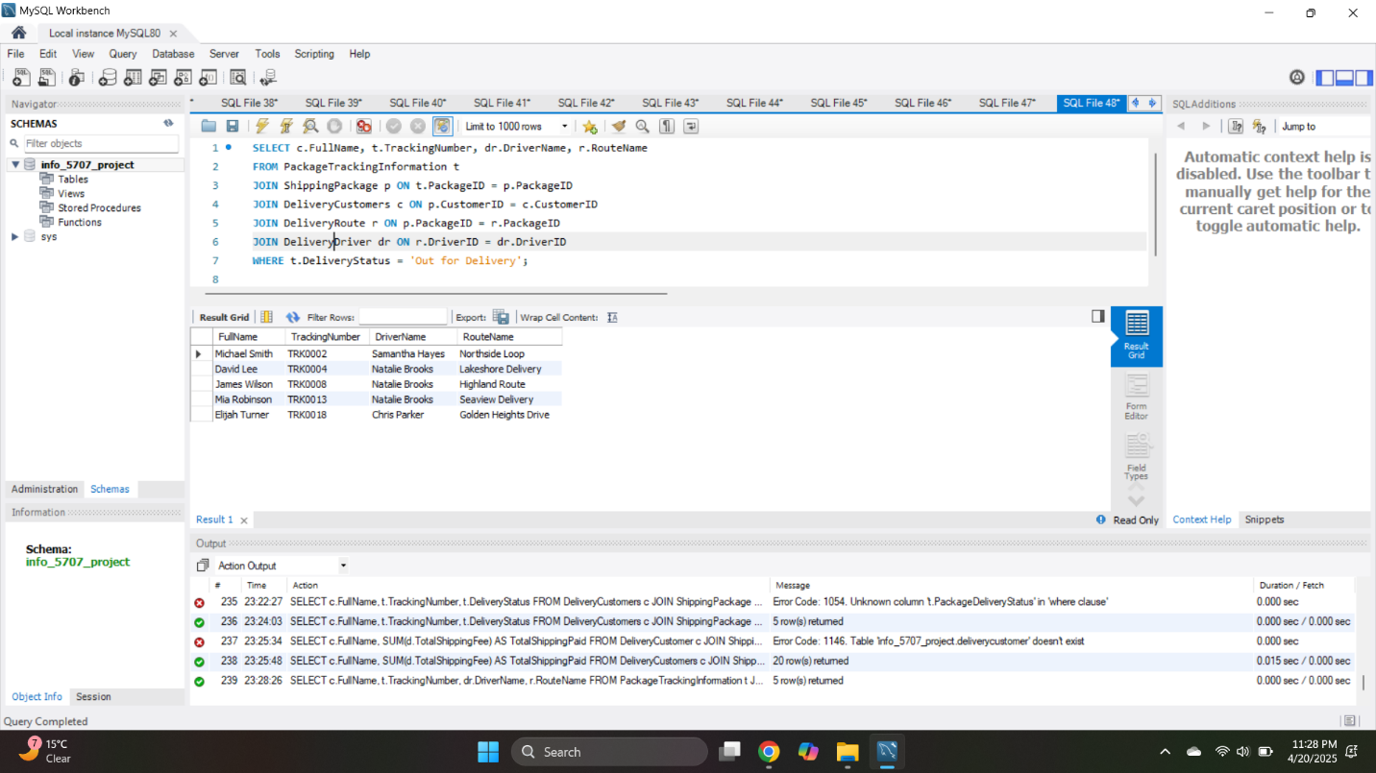
Query Insights: Package Status
Query 3 - Out for Delivery Packages with Drivers and Routes
This joins customer, driver and route details to show packages that are currently marked as "Out for Delivery".
This query is useful for dispatch teams monitoring deliveries that are in-progress and who the drivers are assigned to each delivery.

Slide 10
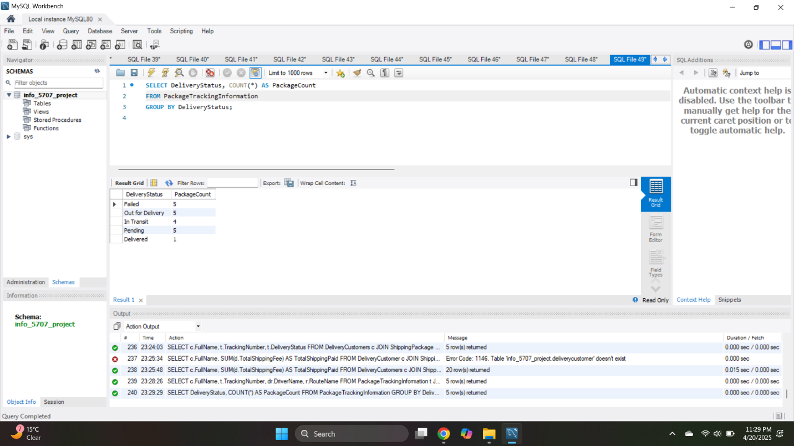
Query Insights: Delivery Breakdown
Query 4 - Delivery Status Count Summary
This groups packages by delivery status and counts how many packages are in each of the statuses.
It is used to create an overview of package status for Executive dashboards, etc.

Slide 11
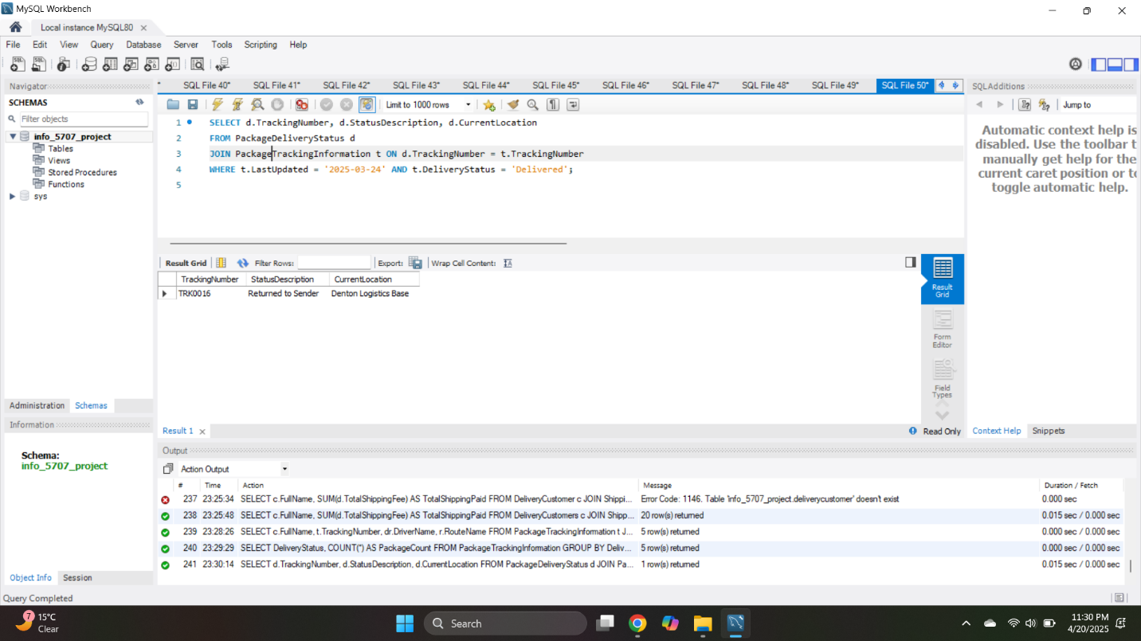
Query Insights: Delivery Breakdown
Query 5 - Delivered Package Details for Each Package on SCDelivery Date
This retrieves tracking numbers, delivery descriptions and location of packages with the delivery status for example “Returned to Sender “.
This query provides a log of successful deliveries or the status of it associated to this specific date.

Slide 12
Conclusion
This postal delivery tracking system is successful with package deliveries due to well organized storage and explicit outlining of customer information, shift e.g. delivery, delivery attempts/closure and customer feedback allow for delivered accountability by administrators.
It provides the administrators with tracking ability- visibility of status delivery/ ledger costs- communicates to the customer through notifications of deliveries and proof of ticket delivery, all this resulted in desired service experience organization and reliability levels.

Slide 13
FUTURE SCOPE
Connect with SMS or email services to send delivery notifications directly to customers.
Create an easy-to-use web or mobile interface so users can track their packages and leave feedback.
Add role-based logged in access for administrators and delivery staff.
Include mapping features so delivery routes can be displayed visually for better coordination.
Generate a QR code for each package, enabling delivery checks and scans.
Expand feedback functionality to include issue reporting and resolution tracking.

Slide 14
THANK YOU

